Slide 1
Predictive linear regression model
Linear regression and normal distribution

Slide 2
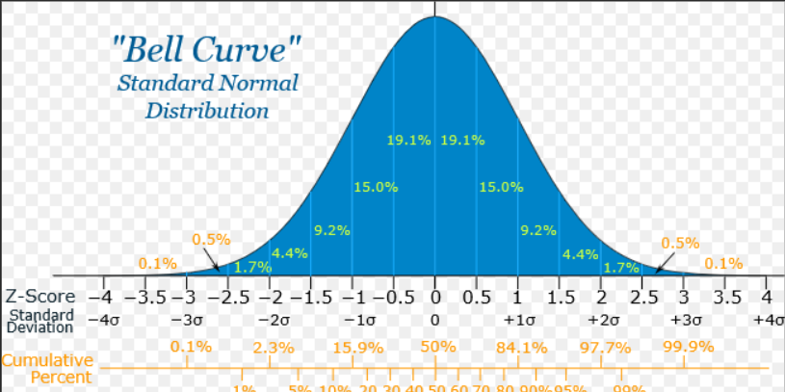
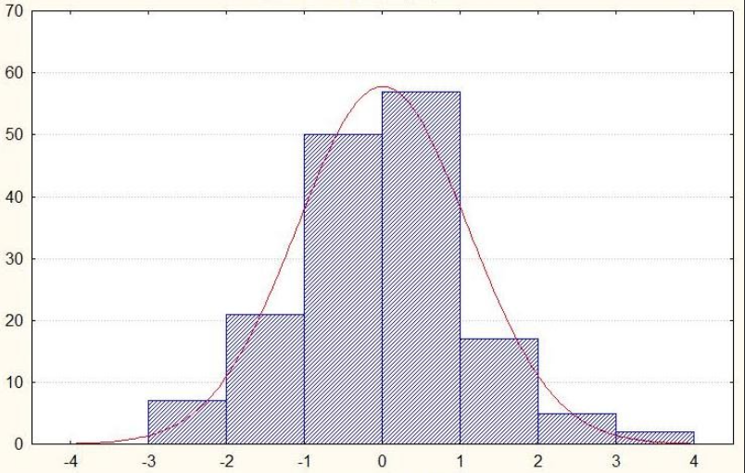

Slide 3
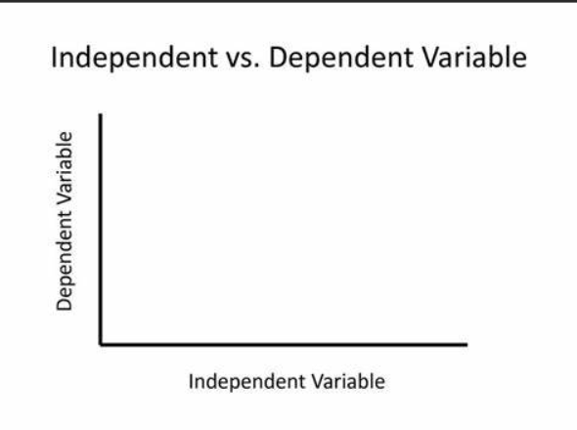
Experiment 1: Plant Growth
Independent Variable: Amount of sunlight
Dependent Variable: Plant growth
Experiment 2: Exam Performance
Independent Variable: Study time
Dependent Variable: Exam score
Experiment 3: Exercise and Weight Loss
Independent Variable: Exercise frequency
Dependent Variable: Weight loss
Experiment 4: Temperature and Ice Melting
Independent Variable: Temperature
Dependent Variable: Rate of ice melting

Slide 4
Simple linear regression is used to estimate the relationship between two quantitative variables. You can use simple linear regression when you want to know:
How strong the relationship is between two variables (e.g., the relationship between rainfall and soil erosion).
The value of the dependent variable at a certain value of the independent variable (e.g., the amount of soil erosion at a certain level of rainfall).
Regression models describe the relationship between variables by fitting a line to the observed data. Linear regression models use a straight line, while logistic and nonlinear regression models use a curved line. Regression allows you to estimate how a dependent variable changes as the independent variable(s) change.

Slide 5
Linear regression is a useful statistical method we can use to understand the relationship between two variables, x and y. However, before we conduct linear regression, we must first make sure that four assumptions are met:
Linear relationship: There exists a linear relationship between the independent variable, x, and the dependent variable, y.
2. Independence: The residuals are independent. In particular, there is no correlation between consecutive residuals in time series data.
3. Homoscedasticity: The residuals have constant variance at every level of x.
4. Normality: The residuals of the model are normally distributed.
If one or more of these assumptions are violated, then the results of our linear regression may be unreliable or even misleading.

Slide 6
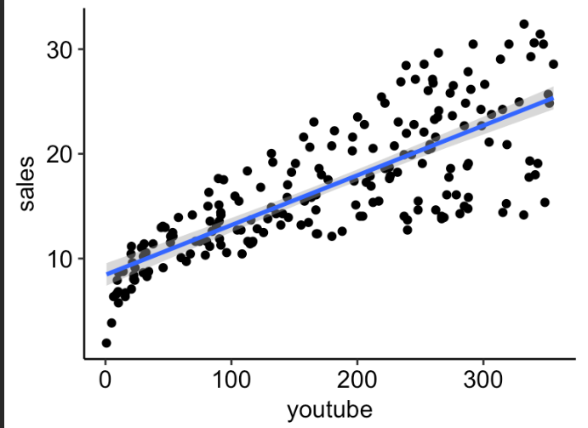
Linear regression
Linear regression is a regression model that uses a straight line to describe the relationship between variables. It finds the line of best fit through your data by searching for the value of the regression coefficient(s) that minimizes the total error of the model.

Slide 7
A null hypothesis in linear regression assumes that the slope value is equals to zero. There is no slope at all.

Slide 8
Building predictive model using linear regression in R
Step 1: Load Required Libraries
Step 2: Load Your Data
Step 3: Normality Check We'll perform Shapiro-Wilk test, T-test, log transformation, and Mann-Whitney test for normality check.
Step 4: Linear Regression After normality check, proceed with linear regression if assumptions are met.
Step 5: Interpret Results Interpret the output of the normality tests and the linear regression model summary.
Remember, for normality:
Shapiro-Wilk test: If p-value > 0.05, data is normally distributed.
T-test: If p-value > 0.05, data is normally distributed.
Mann-Whitney test: If p-value > 0.05, data is normally distributed.
Log transformation: Transform data and re-run normality tests.

Slide 9
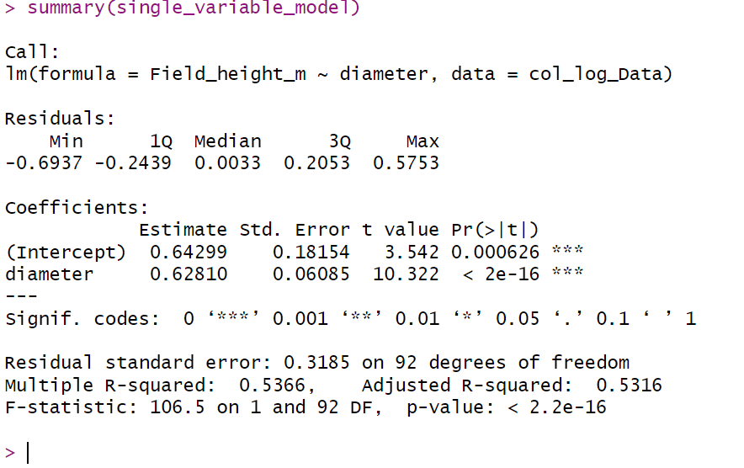
Residuals
P value
Y Intercept
Slope
R Square

Slide 10
Residuals : Distance between observations and the good fitted line. A good fit is that which does not have much residuals. Residuals will be symmetrically distributed around 0. In our case -0.2439 0.0033 0.2053 is around zero so its quite good value.
Y Intercept: The intercept represents the value of the dependent variable (the y-variable) when the independent variable (the x-variable) is zero. It's the point where the regression line intersects the y-axis. In our case result is 0.64299
Slope: The slope represents the change in the dependent variable for a one-unit change in the independent variable. It tells you the rate of change of the dependent variable with respect to the independent variable. In our case slope is 0.62810. That means for every movement along x axis of diameter we move 0.62810 for y axis i.e for the field height.

Slide 11
Interpretation of linear regression model
P-value: The null hypothesis is that the slope is zero, we are seeing a slope of 0.62810. If the slope was really zero then the probability will be extremely low. 2e-16 (2 * 10 to the power -16) Vero low. When p value is less than 0.05 then we reject the null hypothesis and accept that the slope is not equal to zero.
R-squared (R²): This is a measure of how well the independent variable(s) explain the variability of the dependent variable. It ranges from 0 to 1, with higher values indicating a better fit of the model to the data. R-squared measures the proportion of the variance in the dependent variable that is predictable from the independent variable(s). In our case 53.66%
The Std. Error column displays the standard error of the estimate. This number shows how much variation there is in our estimate of the relationship between diameter and field height.
The t value column displays the test statistic. Unless you specify otherwise, the test statistic used in linear regression is the t value from a two-sided t test. The larger the test statistic, the less likely it is that our results occurred by chance.

Slide 12
The last three lines of the model summary are statistics about the model as a whole. The most important thing to notice here is the p value of the model. Here it is significant (p < 0.001), which means that this model is a good fit for the observed data.

Slide 13
Predicting height of the tree manually.
Y = mx + c
Y = dependent variable
m = slope
X = independent variable
C = intercept
Support we want to predict what is the height of the tree whose diameter is equal to 3.5
Y = 0.62810 * 3.5 + 0.64299
= 2.84134 m

